Slide 1
C, C++ ja C# turbeaspektid ja -vahendid
Toivo Pärnpuu

Slide 2
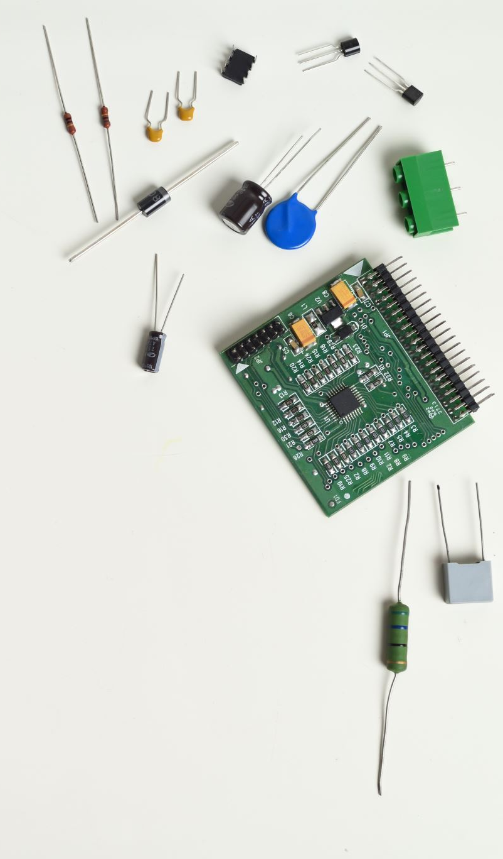
C keeled
C, 1972, Dennis Ritchie
Github: 53 271 projekti;
Op süsteemid, süsteemitarkvara, rakendustarkvara, IoT…
C++, 1985, Bjarne Stroustrup
Github: 56 857 projekti;
Leidub väga paljudes süsteemides;
C#, 2002, Anders Hejlsberg
Github: 56 446 projekti;
Töölaua-, veebirakendused, mängud, IoT…
JS 431 095 projekti GIThub-is

Slide 3
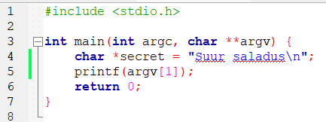
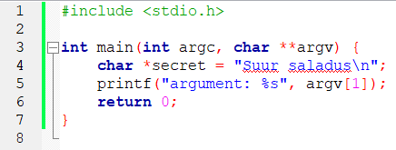
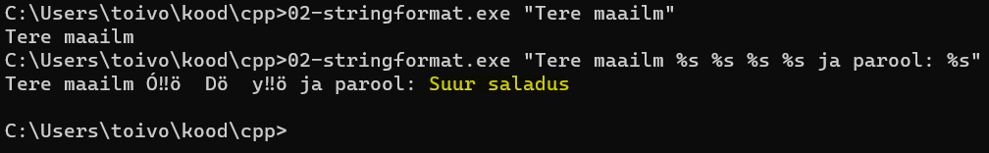
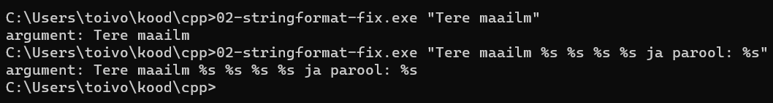
String format
Notes:
Üldine plaan.
Loetlen üles teadaolevad vulnerabilitid.
Enda näite teen vormindusmärgiga (kuigi mälupesa sisu ei kuvata…). https://stackoverflow.com/questions/9053658/correct-format-specifier-to-print-pointer-or-address
Allikas https://security.web.cern.ch/recommendations/en/codetools/c.shtml
Every time printf() encounters a format specifier, it expects to find a suitable variable in its argument list for each format specifier it encounters in the format string. In C programs, variables are saved in the stack. When printf() sees the first %x specifier, it simply refers to the stack and reads the first variable it finds after the format string. This behavior will be repeated for all five %x specifiers in our example. And the result will be that printf() prints the hex representation of five values from its stack. These values could be variable values, function return addresses, function parameters, user input data, or pointer memory addresses, among other data points. (https://www.comparitech.com/blog/information-security/format-string-attack/)

Slide 4
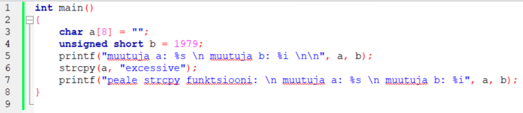
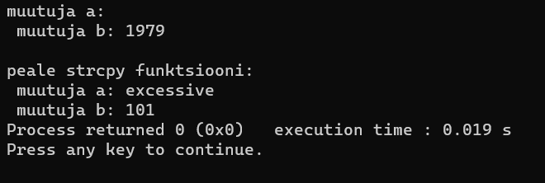
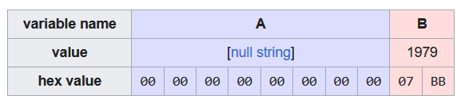
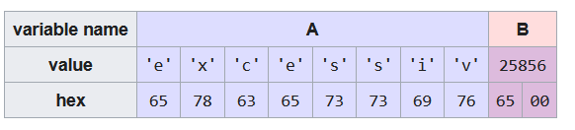
C ja C++ puhvri ületäitumine (buffer overflow)
Notes:
Vaata ka https://owasp.org/www-community/vulnerabilities/Buffer_Overflow

Slide 5


Kuidas seda ennetada?
Vali teine programmeerimiskeel (C, C++ omavad mälule otse ligipääsu)
Kasuta vastavaid turvateeke (secure libraries)
Enne kui alustad rakenduse loomisega tutvu turvalise programmeerimise (secure coding) põhimõttega;
C#
SEI CERT C Coding Standard
SEI CERT C++ Coding Standard

Slide 6
Veel soovitusi
Alustuseks: https://www.cprogramming.com/tutorial/secure.html
https://www.perforce.com/blog/qac/secure-coding-standards
https://learn.microsoft.com/en-us/cpp/c-runtime-library/security-enhanced-versions-of-crt-functions?view=msvc-170
SEI CERT C Coding Standard: Rules for Developing Safe, Reliable, and Secure Systems (2016 Edition)
OWASP
ASVS
https://resources.infosecinstitute.com/wp-content/uploads/Top-dot-Net-Secure-Coding.pdf
Notes:
https://www.cprogramming.com/tutorial/secure.html

Slide 7


Tänan

Slide 8
Allikad
https://github.com/topics/c
https://github.com/topics/cpp
https://github.com/topics/csharp
https://stackoverflow.com/questions/20839352/why-is-c-used-as-the-main-programming-language-for-operating-systems
https://hackernoon.com/why-and-where-should-you-still-use-cc-languages-6l1r838gh
https://owasp.org/www-community/vulnerabilities/Buffer_Overflow
https://www.fortinet.com/resources/cyberglossary/buffer-overflow
https://security.web.cern.ch/recommendations/en/codetools/c.shtml

